Slide 1
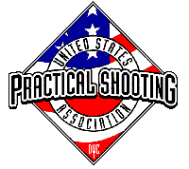
Bay 6, Stage 7 RFGC Bowling League Course Designer: Jordan Rogers
RFGC Bowling League is a 20 round, 100 point Comstock medium course. There are 7 USPSA targets and 6 steel targets. The best two hits per target will score. Steel must fall to score. The start signal is audible.
The Handgun start position is anywhere inside either shooting area, handgun UNLOADED and holstered. The PCC start position is anywhere inside either shooting area, PCC UNLOADED, stock on belt, muzzle pointing down range.
On the audible start signal, engage targets as visible from within the shooting areas. THE LAST 3 TARGETS MUST BE ENGAGED WEAK HAND/SIDE ONLY. All barrels are soft cover.

Slide 2
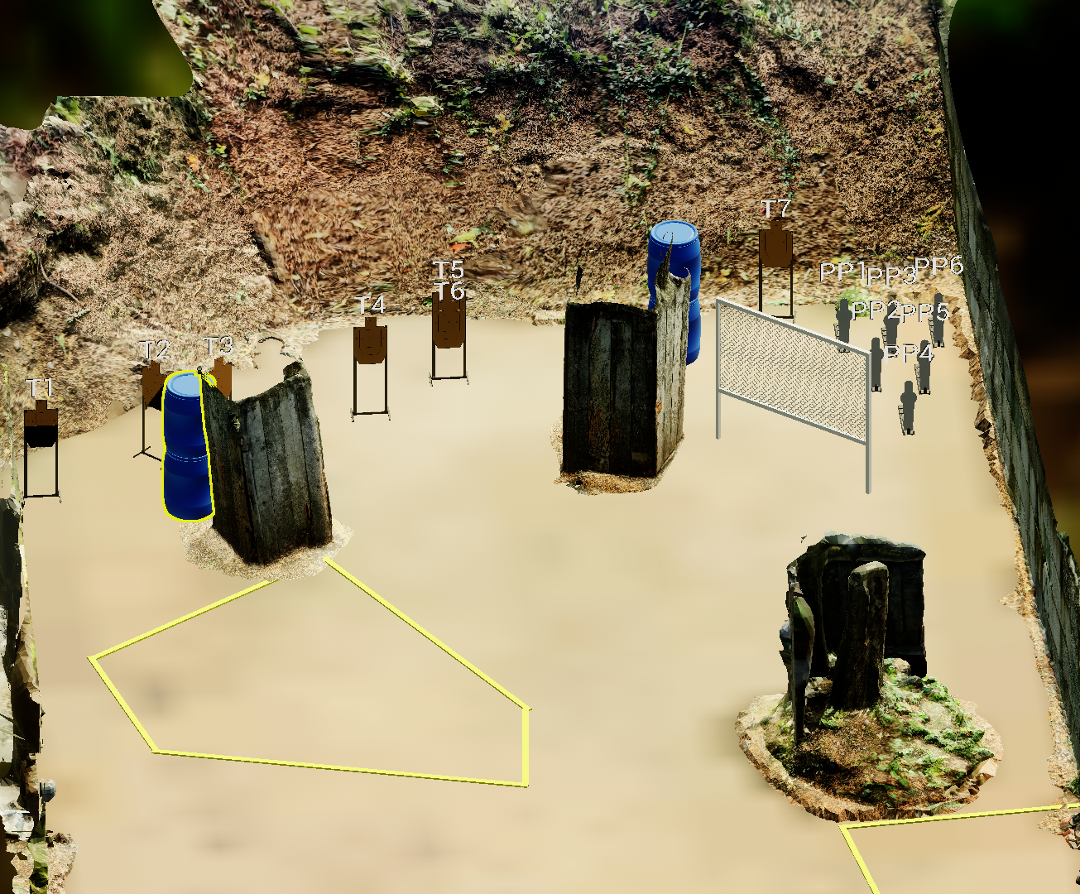
 | Stage 7 RFGC Bowling League Course Designer: Jordan Rogers

